Slide 1
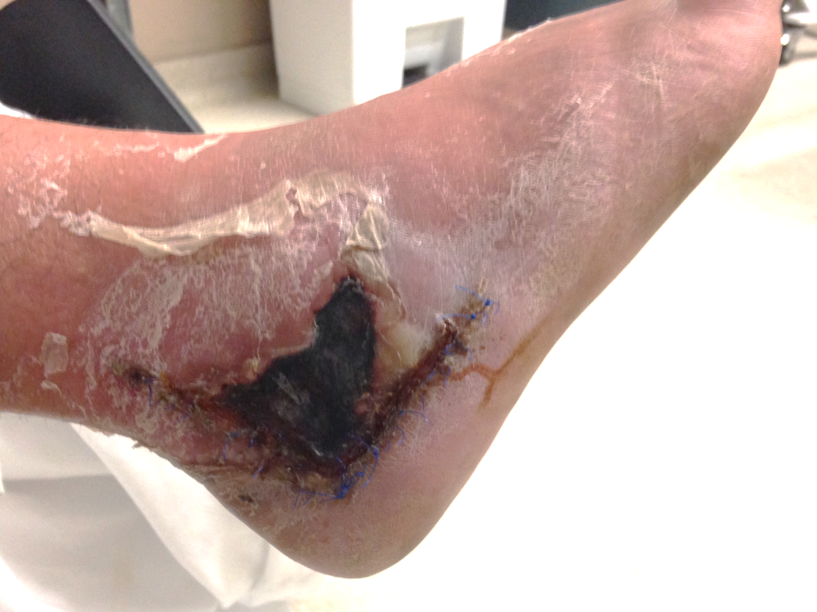
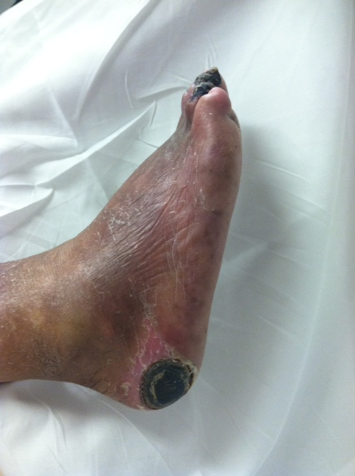
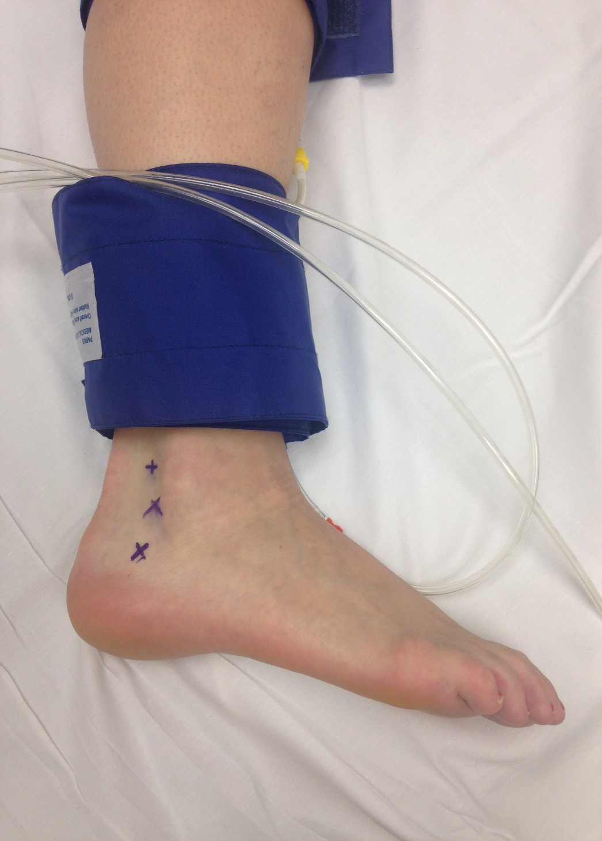
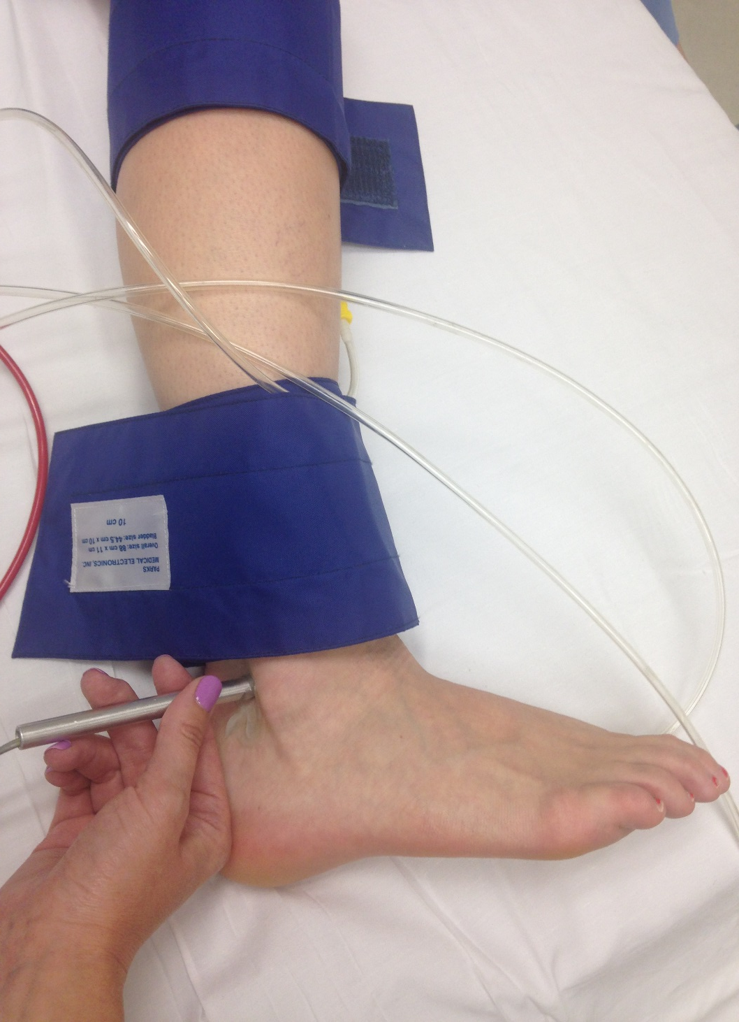
Quantitative Assessment of Peroneal Artery Perfusion at the Ankle with Non-Invasive Vascular Testing Whitney Ellis McConnell, DPMª, Amanda Taylor, BS RDCS RVT^{b}, Patrick Kelly, BS RVT MBA^{b}, and Andrew J. Meyr, DPM FACFAS^{c} ªResident, Temple University Hospital Podiatric Surgical Residency Program, Philadelphia, Pennsylvania ^{b}Temple University Hospital Vascular Laboratory, Philadelphia, Pennsylvania ^{c}Associate Professor and Residency Program Director, Department of Podiatric Surgery, Temple University School of Podiatric Medicine and Temple University Hospital, Philadelphia, Pennsylvania (AJMeyr@gmail.com)* *Please don’t hesitate to contact AJM with any questions/concerns. He’s happy to provide you with a .pdf of this poster if you email him.
Statement of Purpose and Literature Review
Methodology
Results
Bibbo recently demonstrated an 83% wound complication rate with the lateral extensile approach for calcaneal fracture ORIF in 6 patients without a pre-operative Doppler signal of the peroneal artery at the ankle versus a 1% wound complication rate in 84 patients with an identifiable Doppler signal of this artery (Figure 1) [1].
Although the foot and ankle derives its arterial supply from a combination of the anterior tibial artery (ATA), posterior tibial artery (PTA) and peroneal artery (PA), the focus of clinical examination techniques and non-invasive vascular testing is primarily on the ATA and PTA, and not on the PA. This is despite the fact that the PA serves as the primary source artery to two angiosomes of the foot [2], and numerous foot and ankle reconstructive procedures involve a lateral rearfoot incision within these two angiosomes including calcaneal fractures, ankle and subtalar arthrodeses, posterior calcaneal translational osteotomies, lateral column lengthenings, reverse sural flaps, lateral ankle stabilizations, etc [3-6].
Additionally, when considering diabetic limb salvage, the PA is the infrapopliteal vessel most likely to be spared of chronic obstructive atherosclerotic disease and may represent the primary arterial supply to the foot in many patients suffering from the consequences of diabetic foot disease [7,8]. Further still, decubitus ulcerations of the heel generally occur on the posterior-lateral portion within the peroneal angiosome [9].
All of this has lead us to believe that quantitative assessment of the peroneal artery could have clinical utility and influence medical decision making for foot and ankle surgeons. The objectives of the present investigation were to 1) evaluate the feasibility of incorporating assessment of the peroneal artery into a standard non-invasive vascular testing protocol, and 2) collect normative data of systolic pressure measurement of the peroneal artery at the ankle.
Following approval by our institutional review board (Protocol #23164), we attempted to locate a Doppler signal of the PA posterior to the lateral malleolus in consecutive patients undergoing our institution’s standard protocol for lower extremity non-invasive vascular testing with the ankle-brachial index (ABI) and photoplethysmography. If located, a systolic pressure measurement was performed and recorded of the PA in addition to the ATA and PTA. These were patients with already diagnosed or suspected peripheral arterial disease with the non-invasive testing ordered by a vascular surgeon.
We further performed this non-invasive testing protocol on a cohort of healthy volunteers without peripheral arterial disease or any lower extremity complaint in an attempt to establish basic normative data.
A frequency count was performed of limbs in both cohorts in which a systolic pressure measurement from the PA with available calculation of an ABI based on the PA was possible, in addition to descriptive statistics (mean, standard deviation, range) of pressure measurements.
First, we found that incorporating the peroneal artery into a non-invasive arterial testing protocol was feasible. The artery was identified with the Doppler device posterior to the lateral malleolus with a systolic pressure recording available in a large majority of both cohorts (94.0% of 100 total limbs). We found that this added less than 5minutes to the performance of the non-invasive testing protocol.
Second, we found PA pressure measurements generally equivalent to that of the ATA and PTA. In our cohort with PAD, the mean brachial pressure was 142.0mmHg, the mean PTA pressure was 138.7mmHg (corresponding ABI 0.98), the mean ATA pressure was 139.7mmHg (corresponding ABI 0.98), and the mean PA pressure was 130.3mmHg (corresponding ABI 0.92).
In our cohort without PAD, the mean brachial pressure was 114.2mmHg, the mean PTA pressure was 128.4mmHg (corresponding ABI 1.12), the mean ATA pressure was 120.6mmHg (corresponding ABI 1.06), and the mean PA pressure was 117.6mmHg (corresponding ABI 1.03).
Figures 2: Identification and measurement of the peroneal artery with non-invasive vascular testing.
Table 1: Investigation results of the primary outcome measure
 | Patients with non-invasive testing ordered by a vascular surgeon (n=25 participants; 50 limbs) | Healthy volunteers without peripheral arterial disease (n=25 participants; 50 limbs)
Frequency count (%) of limbs with a dopplerable peroneal artery | 46 (92.0%) of 50 limbs | 48 (96.0%) of 50 limbs
Mean ± SD (range) anterior tibial artery pressure (in mmHg)/ ABI calculated with the anterior tibial artery | 138.7 ± 48.7 (54-255)/ 0.98 | 120.6 ± 18.23 (90-170)/ 1.06
Mean ± SD (range) posterior tibial artery pressure (in mmHg)/ ABI calculated with the posterior tibial artery | 139.7 ± 47.9 (58-255)/ 0.98 | 128.4 ± 20.04 (90-180)/ 1.12
Mean ± SD (range) peroneal artery pressure (in mmHg)/ ABI calculated with the peroneal artery | 130.3 ± 44.7 (54-255)/ 0.92 | 117.6 ± 17.18 (90-160)/ 1.03
Figures 1: Clinical situations involving the peroneal artery and peroneal angiosome.
There are many situations in which foot and ankle surgeons deal with an incision or pathology within the peroneal angiosome on the lateral rearfoot. The top figure demonstrates a necrotic, dehisced lateral extensile incision for a calcaneal fracture while the central figure depicts a decubitus ulceration with eschar. Both areas are primarily supplied by braches of the peroneal artery. The bottom figure is an angiogram of a diabetic patient with PAD in which the peroneal artery serves as the primary run-off to the foot without a distinguishable posterior tibial artery or anterior artery visualized. Note the pathognomonic peroneal “delta” or terminal bifurcation of the artery at the ankle.
Discussion
The results of this investigation provide unique information on a previously underappreciated aspect of lower extremity vascular anatomy with the potential to affect rearfoot surgical decision making and planning. We believe that all foot and ankle surgeons should be knowledgeable about the vascular anatomy and arterial inflow to a planned incision site, and that these results provide surgeons with an objective means to do so. We also believe that these results have the potential to affect not just reconstructive foot and ankle surgeons, but also vascular surgeons and anyone working within the realm of the diabetic foot.
References
[1] Bibbo C, Ehrlich DA, Nguyen HM, Levin LS, Kovach SJ. Low wound complication rates for the lateral extensile approach for calcaneal ORIF when the lateral calcaneal artery is patent. Foot Ankle Int. 2014 Jul; 35(7): 650-6.
[2] Attinger CE, Evans KK, Bulan E, Blume P, Cooper P. Angiosomes of the foot and ankle and clinical implications for limb salvage: reconstruction, incisions, and revascularization.
[3] Benirschke SK, Kramer PA. Wound healing complications in closed and open calcaneal fractures. J Orthop Trauma. 2004 Jan; 18(10): 1-6.
[4] Raines RA, Brage ME. Evans osteotomy in the adult foot: an anatomic study of structures at risk. Foot Ankle Int. 1998 Nov; 19(11): 743-7.
[5] Phisitkul P, Haugsdal J, Vaseenon T, Pizzimenti MA. Vascular disruption of the talus: comparison of two approaches for triple arthrodesis. Foot Ankle Int. 2013 Apr; 34(4): 568-74.
[6] Jolly GP, Zgonis T. Soft tissue reconstruction of the foot with a reverse flow sural artery neurofasciocutaneous flap. Ostomy Wound Manage. 2004 Jun; 50(6): 44-9.
[7] Ciavarella A, Silletti A, Mustacchio A, Gargiulo M, Galaverni MC, Stella A, Vannini P. Angiographic evaluation of the anatomic pattern of arterial obstrucutions in diabetic patients with crticial limb ischemia. Diabete Metab. 1993 Nov-Dec; 19(6): 586-9.
[8] Faglia E, Favales F, Quarantiello A, Calia P, Clelia P, Brambilla G, Rampoldi A, Morabito A. Angiographic evaluation of peripheral arterial occlusive disease and its role as a prognostic determinant for major amputation in diabetic subjects with foot ulcers. Diabetes Care. 1998 Apr; 21(4): 625-30.
[9] Hayashi A, Maruyama Y. Lateral calcaneal V-Y advancement flap for repair of posterior heel defects. Plast Reconstr Surg. 1999 Feb; 103(2): 577-80.

