Slide 1
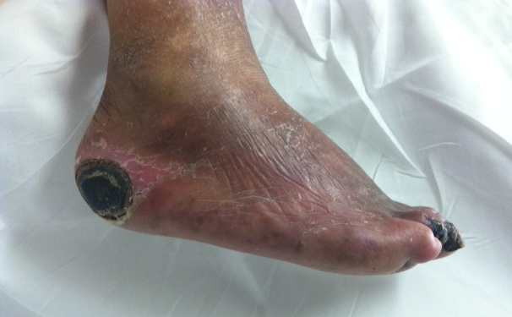
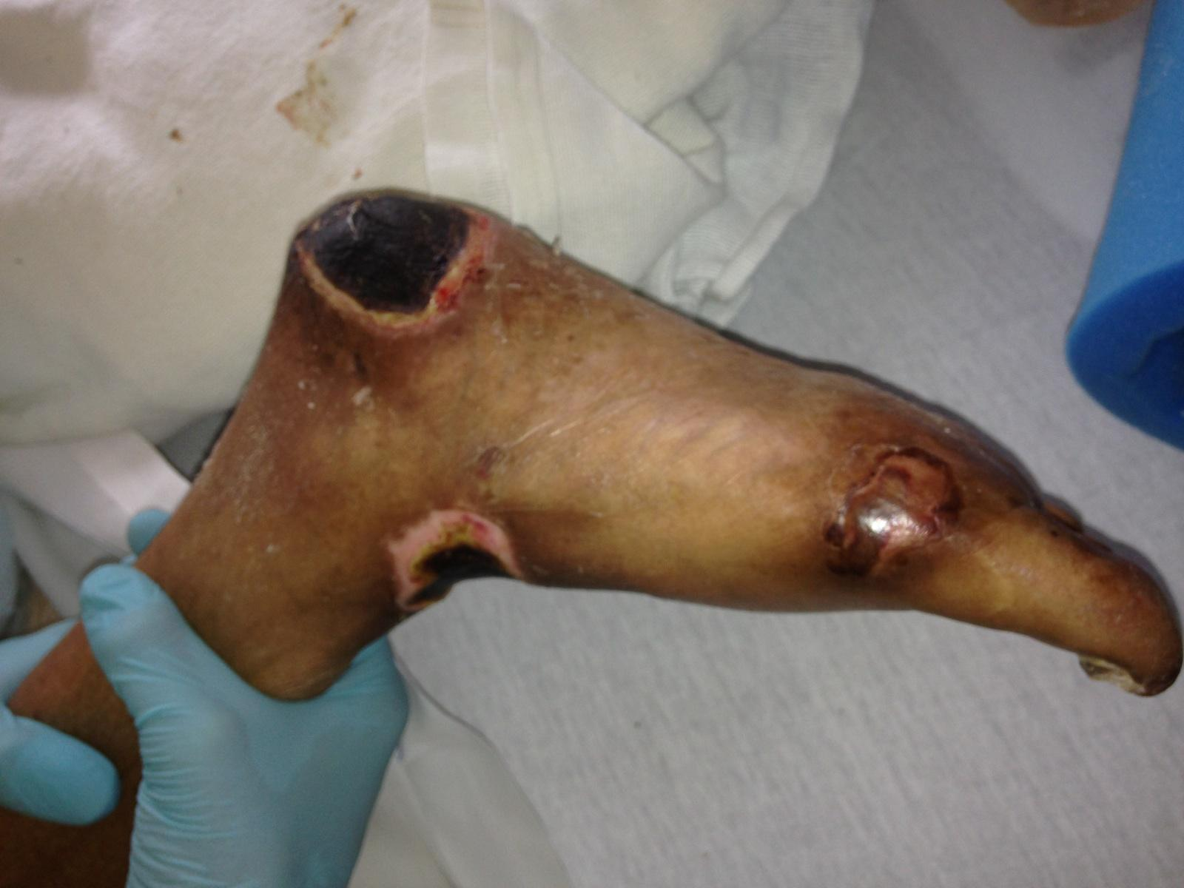
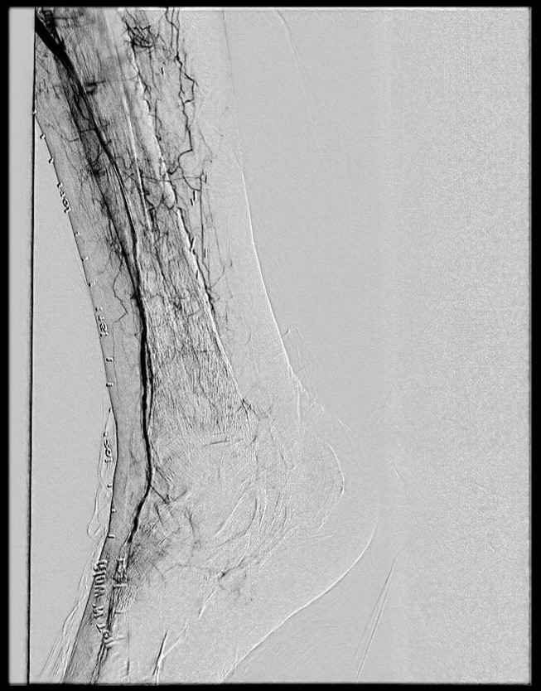
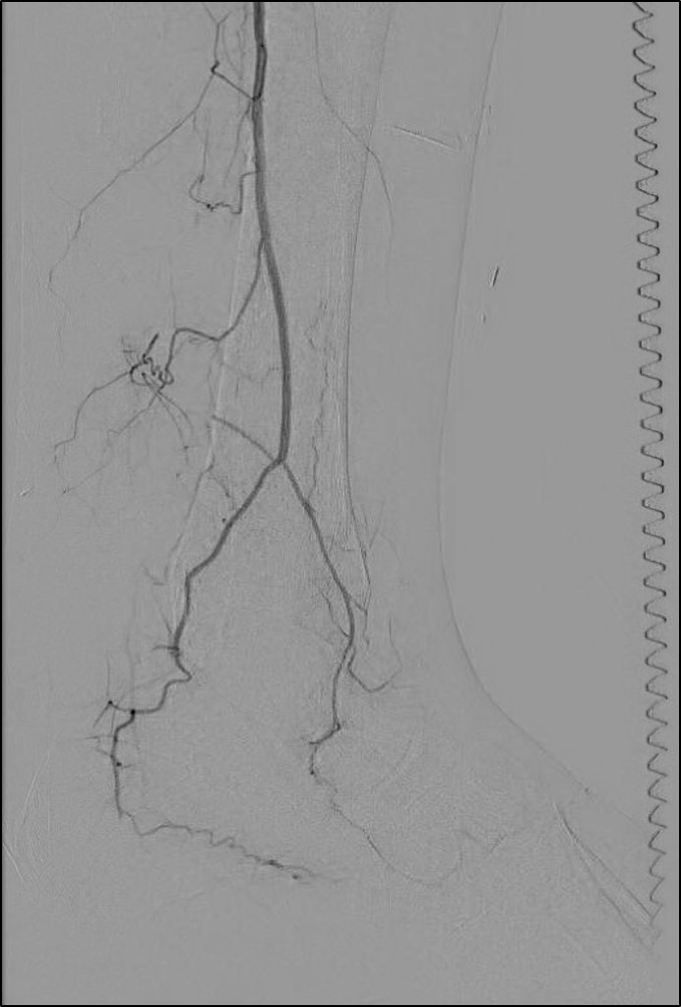
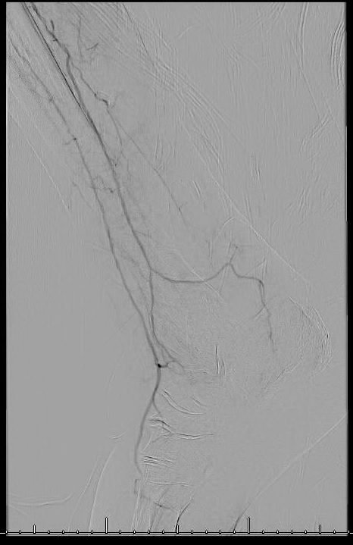
Accuracy of the Ankle-Brachial Index in the Assessment of Arterial Perfusion of Heel Decubitus Ulcerations Amanda Wiest, DPMª and Andrew J. Meyr, DPM FACFAS^{b} ªResident, Temple University Hospital Podiatric Surgical Residency Program, Philadelphia, Pennsylvania ^{b}Associate Professor and Residency Program Director, Department of Podiatric Surgery, Temple University School of Podiatric Medicine and Temple University Hospital, Philadelphia, Pennsylvania (AJMeyr@gmail.com)* *Please don’t hesitate to contact AJM with any questions/concerns. He’s happy to provide you with a .pdf of this poster if you email him.
Statement of Purpose and Literature Review
Results
Figures
The development and treatment of decubitus ulcerations are a significant and expensive sequela of the aging population. Specific to the lower extremity, this is particularly true in those that are non-ambulatory, those that are bedridden for any period of time, and in the presence of certain co-morbidities including peripheral arterial disease and diabetes mellitus. Part of the initial clinical work-up of any patient with lower extremity tissue loss involves an assessment of the arterial blood flow by means of non-invasive vascular testing (ankle-brachial index [ABI] and pulse volume recording). Unfortunately however, this may be misleading in patients with heel decubitus ulcerations if the ABI provides information primarily about arterial flow to the dorsum of the foot instead of the posterior heel, or in the presence of vessel calcification leading to falsely elevated results.
The objective of this retrospective, observational investigation was to determine if non-invasive vascular testing provides accurate and reliable results in patients with heel decubitus ulcerations.
Ninety-two decubitus ulcerations in 83 patients meeting inclusion criteria were identified over the 12-month data collection period. Thirty-six (43.37%) of the 92 were right-sided ulcerations, 38 (45.78%) of the 92 were left-sided ulcerations, while 9 (10.84%) patients had bilateral lesions. The mean ± SD (range) age was 60.47 ± 15.18 years (28-90 years). Forty three (51.81%) of the 83 patients were male. Seventy-nine (95.28%) of 83 patients were diabetic and 20 (24.10%) of 83 were on hemodialysis. The location of the ulceration described as “plantar” in 29 (31.52%) of 92 feet, “posterior” in 20 (21.74) of 92 feet, “posterior-lateral” in 17 (18.48%) of 92 feet, “posterior-medial” in 5 (5.43%) of 92 feet, and was undocumented in 21 (22.83%) of 92 feet.
An ABI was performed on 67 (80.72%) of the 83 patients including 75 (81.52%) of the 92 feet. A vascular surgery consultation was obtained on 37 (44.58%) of the 83 patients with performance of an angiogram in 12 (14.4%) of 83 patients. Thirty-two (36.78%) of 83 patients had any type of vascular or podiatric procedure during their admission, and 8 (9.64%) of 83 underwent major limb amputation.
In terms of the specific ABI findings, non-compressible vessels were observed in 35 (46.67%) of the 75 feet. Both the ATA and PTA were non-compressible in 26 (34.67%) of 75 feet, just the PTA in 6 (8.0%) of 75 feet, and just the ATA in 3 (4.0%) of 75 feet. No digital pressure reading was observed in 36 (48.0%) of 75 feet.
When at least one compressible vessel was observed allowing for calculation of the ABI (n=49 feet), it was done based on the PTA in 23 (46.94%) of 49 feet and based on the ATA in 26 (53.06%) of 49 feet.
Heel decubitus ulcerations most often occur in patients with multiple co-morbidities and in those with multi-segment arterial occlusive disease. The specific location of the tissue loss with respect to the angiosome principle and arterial inflow likely has implications with respect to healing potential. The ulcerations generally occur within the peroneal (via the peroneal artery) and medial calcaneal (via the posterior tibial artery) angiosomes. In our series of 92 heel decubitus ulcerations, we observed the locations described as “plantar” 32% of the time, “posterior” 22% of the time, “posterior-lateral” 18% of the time, and “posterior-medial” 5% of the time.
A
B
C
Methodology
Discussion
Following approval by our institution’s IRB, we performed a retrospective chart review of consecutive inpatients with heel tissue loss consistent with decubitus ulceration and with consultation by the Foot and Ankle Surgery service. Demographic patient information was collected in addition to the side and location of the ulceration. If available, non-invasive vascular testing results were evaluated for the presence of any non-compressible readings and differences in calculation of the ABI based on the anterior tibial artery vs. the posterior tibial artery.
As with any scientific investigation, critical readers are encouraged to review the study design and results and reach their own conclusions, while the following represents our conclusions based on the specific results. As scientists, we also never consider data to be definitive, but do think that these results are worthy of attention and future investigation.
We believe that the results of this investigation provide health care professionals working with heel decubitus ulcerations clinically relevant information which has the potential to affect medical decision making. Based on the specific results of this study, we primarily conclude that non-invasive vascular testing may be inaccurate and unreliable in many patients with heel decubitus ulcerations. We found evidence of non-compressible vessels leading to no quantitative information or potentially falsely elevated results in 46.67% of feet. Further, in those patients with compressible vessels, we found that the ABI was calculated based on the anterior tibial artery (and thus not a direct measure of heel perfusion) in 53.06% of feet.
Physicians are encouraged to consider the angiosome and direct arterial supply to an area of tissue loss, as opposed to a more general measure of foot perfusion.
Non-invasive vascular testing is often performed in these patients in order to assess arterial inflow and healing potential. For example, this test was performed on 81% of the patients in our retrospective series. However, these results may be inaccurate or unreliable in the presence of arterial calcification leading to non-compressible vessels or falsely elevated results. Evidence of non-compressibility was observed in 47% of the non-invasive vascular tests in our series speaking to a large percentage of potentially unreliable results.
Further, by convention the ABI is reported as the higher value of the anterior tibial artery (ATA) or posterior tibial artery (PTA) at the ankle. Because of this, the ABI may not provide any direct information about the perfusion of the heel. Figure A above demonstrates an angiogram with a single vessel ATA run-off without appreciable PTA or peroneal artery (PA). The reported ABI in this case would almost certainly be calculated based on the ATA which does not speak to the perfusion of the heel. Figure B presents another potential problem with the ABI. Here there is single vessel run-off through the PA which may supply the heel, but is not measured or recorded in standard non-invasive testing. Figure C demonstrates a case with ATA and PA run-off. The heel is likely supplied through the PA, but the ABI would most likely be reported based on the ATA. In our series of 92 feet with tissue loss involving the posterior tibial and/or peroneal angiosomes, the ABI was reported based on the ATA 53% of the time speaking to a large percentage of potentially inaccurate results.
References
[1] Attinger CE, Evans KK, Bulan E, Blume P, Cooper P. Angiosomes of the foot and ankle and clinical implications for limb salvage: reconstruction, incisions, and revascularization. Plast Reconstr Surg. 2006 Jun; 117(7 Suppl): 261S-293S.
[2] Ellis W, Taylor A, Kelly P, Meyr AJ. Quantitative assessment of peroneal artery perfusion at the ankle with non-invasive vascular testing. Poster presentation
[3] [3] Sacks D, Bakal CW, Beatty PT, Becker GJ, Cardella JF, Raabe RD, Wiener HM, Lewis CA; Standards Division of the Society of Interventional Radiology. J Vasc Interv Radiol. 2003 Sep; 14(9 Pt 2): S389.
[4] Xu D, Zou L, Xing Y, Hou L, Wei Y, Zhang J, Qiao Y, Hu D, Xu Y, Li J, Ma Y. Diagnostic value of ankle-brachial index in peripheral arterial disease: a meta-analysis. Can J Cardiol. 2013 Apr; 29(4): 492-8.
[5] Ko SH, Bandyk DF. Interpretation and significance of ankle-brachial systolic pressure index. Semin Vasc Surg. 2013 Jun-Sep; 26(2-3): 86-94.
[6] Ferket BS, Spronk S, Colkesen EB, Hunink MG. Systematic review of guidelines on peripheral artery disease screening. Am J Med. 2012 Feb; 125(2): 198-208.
[7] Bird CE, Crigui MH, Fronek A, Denenberg JO, Klauber MR, Langer RD. Quantitative and qualitative progression of peripheral arterial disease by non-invasive testing. Vasc Med. 1999; 4(1): 15-21.

