Slide 1
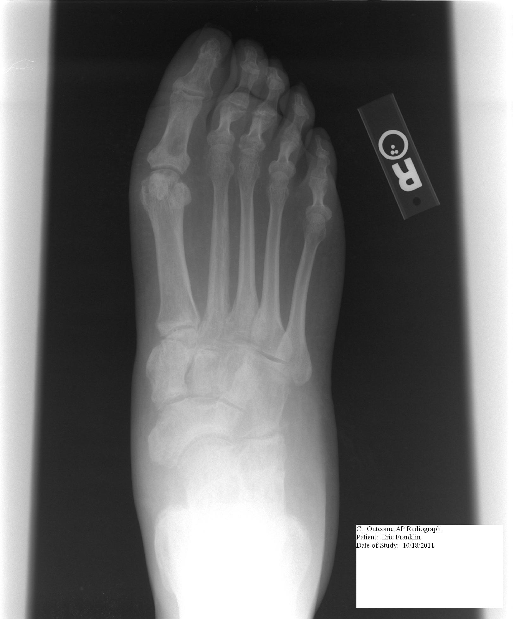
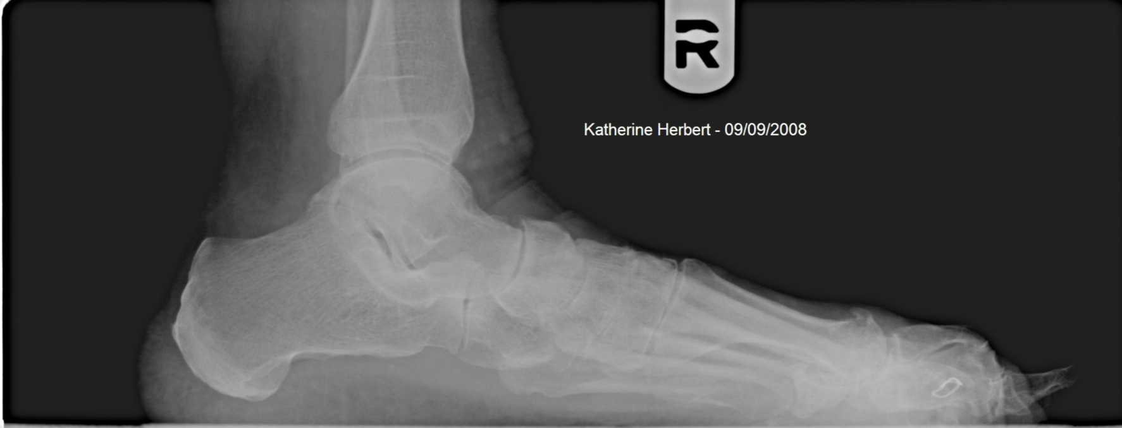
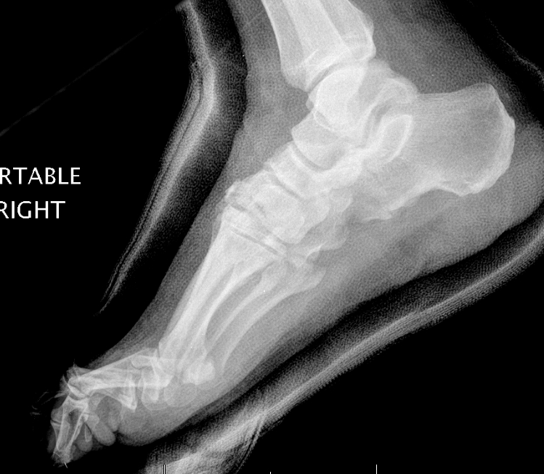
A Pictorial Review of Reconstructive Foot and Ankle Surgery: Evaluation and Intervention of the Flatfoot Deformity Andrew J. Meyr, DPM FACFASª, Laura Sansosti, DPM^{b}, and Sayed Ali, MD^{c} ªAssociate Professor, Department of Podiatric Surgery, Temple University School of Podiatric Medicine, Philadelphia, Pennsylvania (AJMeyr@gmail.com)* ^{b}Resident, Temple University Hospital Podiatric Surgical Residency Program, Philadelphia, Pennsylvania ^{c}Associate Professor, Department of Radiology, Temple University Hospital, Philadelphia, Pennsylvania *Please don’t hesitate to contact AJM with any questions/concerns. He’s happy to provide you with a .pdf of this poster if you email him.
Statement of Purpose
Transverse Plane
The intention of this review is to present radiologists with a basic overview of common procedures performed within the field of podiatric foot and ankle reconstructive surgery. This article specifically focuses on elective procedures of the midfoot and rearfoot used for correction of the flatfoot deformity. Our goal is to emphasize radiographic findings that surgeons utilize to pre-operatively evaluate deformity and judge post-operative outcomes. It is our hope that radiologists will employ this information to improve their ability to assess post-operative radiographs following reconstructive foot surgeries.
The anterior-posterior (AP) or dorsal-plantar (DP) foot radiograph is most useful for assessment of the transverse component of the deformity. Several angular measurements are performed to define transverse plane deformity:
-The talocalcaneal angle (TCA; Kite’s angle) is the resultant angulation between the longitudinal axis of the talar head/neck and a tangent to the lateral side of the calcaneus. A normal angle is between 25-40 degrees, with angles greater than 40 degrees indicative of transverse plane flatfoot deformity. (Figure 1A)
-The calcaneocuboid angle (CCA) is the resultant angulation between tangents drawn along the lateral side of the cuboid and the lateral side of the calcaneus. A normal angle is between 0-5 degrees, with angles greater than 5 degrees indicative of transverse plane flatfoot deformity (Figure 1B).
-A final radiographic parameter evaluates the degree of articulation between the talar head and navicular (talar head coverage). Normally approximately 75% of the talar head is “covered” by the navicular, with less coverage indicative of transverse plane flatfoot deformity (Figure 1C).
Fig 1A: Talocalcaneal angle. Normal value 25-40 degrees; Increases with flatfoot deformity.
Fig 1B: Calcaneocuboid angle. Normal value 0-5 degrees; Increases with flatfoot deformity.
Fig 1C: Talar head coverage. Normal value ~75-100%; Decreases with flatfoot deformity.
The most common osseous procedure used for correction of transverse plane flatfoot deformity is the Evans calcaneal osteotomy. This is a wedge of bone graft inserted into the lateral aspect of the calcaneus that literally “lengthens” the lateral column and “pushes” the midfoot and forefoot back on top of the calcaneus (Figure 1D). This may be fixated with a screw or wire, or without fixation. Following this procedure, one would expect correction of all transverse plane radiographic measurement to normal, and in fact, the size of the utilized graft is often determined by the talar head coverage.
Additionally, radiologists may also see a a radioopaque bone anchor in the medial navicular when a tendon transfer is performed for transverse plane deformity (Figure 1E).
Fig 1D: During the Evans calcaneal ostetomy, a wedge shaped bone graft is inserted into the lateral calcaneus to “lengthen” the lateral column and “push” the midfoot/forefoot back on top of the talus.
Fig 1E: Tendon transfer, either advancement of the posterior tibial tendon or transfer of the flexor digitorum longus tendon, involves reattachment to the navicular tuberosity by means of a bone anchor. One can also appreciate visible Evans and Cotton grafts.
α
*
α
Flatfoot Deformity Clinical Presentation
Sagittal Plane
Flatfoot deformity, also referred to as “pes valgus,” “pes planovalgus,” or “peritalar subluxation,” is most readily characterized by a relatively simple and subjective “collapse” of the medial arch of the foot. In fact, however, it is a complex deformity involving osseous, articular, and soft tissue pathology with both clinical and radiographic signs being evident in all three cardinal body planes – transverse, sagittal and frontal.
A complete physical examination is performed including non-weight bearing and a dynamic weight bearing gait examination. A systematic series of radiographs is also performed to evaluate all three planes. Because nearly all foot and ankle deformities have a dynamic biomechanical component, it is important to always evaluate the deformity with only weight-bearing radiographs taken in the ankle and base of gait.
The lateral foot/ankle radiograph is most useful for assessment of the sagittal component of the deformity. Several angular measurements are performed to define sagittal plane deformity:
-The talar declination angle (TDA) is the resultant angle between the supporting surface and the longitudinal axis of the talar head and neck. A normal value is between 18-24 degrees, with angles greater than 24 degrees indicative of sagittal plane flatfoot deformity.
-The calcaneal inclination angle (CIA) is the resultant angle between the supporting surface and a line tangential to the plantar aspect of the calcaneus. A normal value is between 18-24 degrees, with angles less than 18 degrees indicative of sagittal plane flatfoot deformity.
-The talo-first metatarsal angle (Meary’s angle) is defined by the resultant angle between the longitudinal bisections of the first ray and the talar head/neck. In a normal foot type, these lines would be parallel, with angles greater than 4 degrees indicative of sagittal plane flatfoot deformity (All demonstrated in Figure 2A).
Fig 2A: Radiographic depiction of the calcaneal inclination angle (CIA), talar declination angle (TDA) and lateral talo-first metatarsal angle (Meary’s angle).
The primary surgical intervention for correction of sagittal plane flatfoot deformity is soft tissue in nature, and therefore, not visible radiographically. This comes in the form of either an Achilles tendon lengthening or gastrocnemius recession.
However, one osseous procedure that is performed is the Cotton osteotomy, which consists of a wedged bone graft inserted into the superior aspect of the medial cuneiform. This will literally plantarflex, or “push down,” the first metatarsal. This will cause an immediate reduction in Meary’s angle (Figure 2B).
Meary’s angle
CIA
TDA
References
Frontal Plane
[1] Sanner WH. Foot segmental relationships and bone morphology. In: Christman RA, editor. Foot and Ankle Radiology. St. Louis, Missouri: Churchill Livingstone; 2003. P. 272-302.
[2] Weissman SD. Biomechanically acquired foot types. In Radiology of the Foot, pp 66-90, edited by SD Weissman, Philadelphia, 1983.
[3] Gamble FO, Yale I. Orthodigital problems. In Clinical Foot Roetengenology, pp 248-270, edited by FO Gamble, I Yale, Robert E. Krieger Publishing Company, New York, 1975.
[4] Mahan KT, Flanigan KP. Flexible valgus deformity. In McGlamry’s Comprehensive Textbook of Foot and Ankle Surgery, pp 585-597, edited by JT Southerland, JS Boberg, MS Downey, A Nakra, LV Rabjohn, Lippincott, Williams and Wilkins, Philadelphia, 2012.
[5] Meyr AJ, Wagoner MR. Descriptive quantitative analysis of rearfoot alignment radiographic parameters. Article in Press: The Journal of Foot and Ankle Surgery.
The frontal plane is poorly defined with standard radiographic series and therefore ancillary views should also be obtained, most commonly the long leg calcaneal axial which can identify the talus and calcaneus in a rectus, varus or valgus position relative to the tibia (Figure 3):
-The longitudinal axis of the tibia is compared to the longitudinal axis of the calcaneus. This will define the frontal plane positioning.
-The longitudinal axis of the tibia is also extended to evaluate the “calcaneal strike position,” or the relationship of the calcaneal tuber to this extended line. These should be within approximately 5mm of each other.
Figure 3A: This figure demonstrates a pre-operative patient with a frontal plane component to their flatfoot deformity. One can appreciate that the calcaneus is in varus relative to the long axis of the tibia, and that center of the calcaneal tuber strikes the ground well lateral to an extension of the tibial axis.
There are two procedures primarily used for correction of a frontal plane component to flatfoot deformity. The first is the medial calcaneal slide procedure which involves an osteotomy through the calcaneal tuber and medial translation of the posterior fragment. This is nearly always stabilized with internal fixation, most commonly one or two screws (Figure 3B).
In pediatric patients, a subtalar joint arthroeresis is sometimes inserted into the sinus tarsi to control frontal plane motion (Figure 3C).
Fig 3B: Post-operative radiograph following a medial calcaneal slide osteotomy. Note the more rectus alignment of the tibial axis to the calcaneus, and the translation of the calcaneal tuber closer to an extension of the tibial axis.
Fig 3C: This radiograph demonstrates a subtalar arthroeresis implant appropriately placed within the subtalar joint to control frontal plane motion. This procedure is typically performed on pediatric patients as opposed to adult patients.

