Slide 1
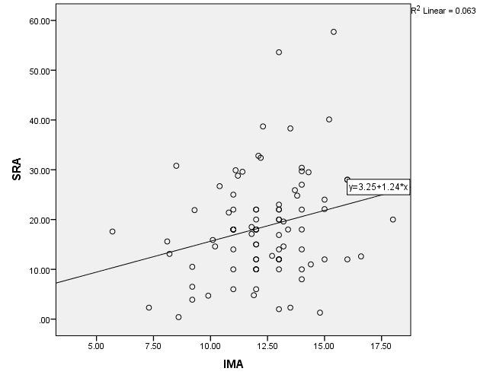
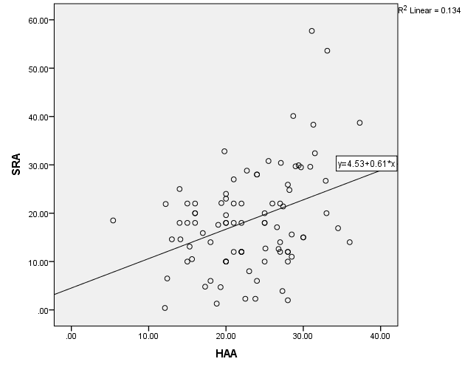
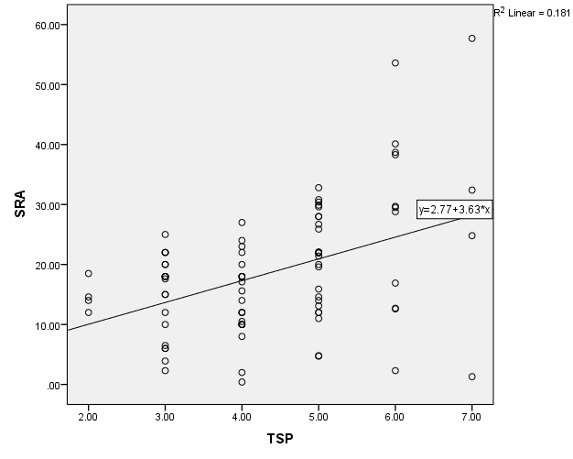
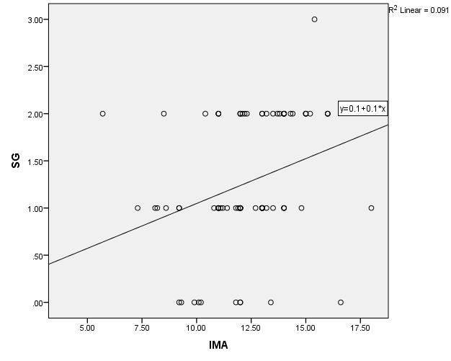
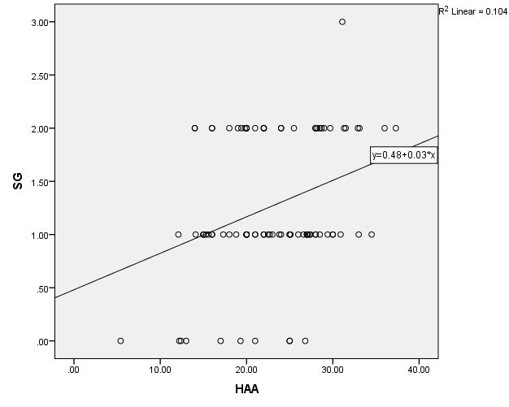
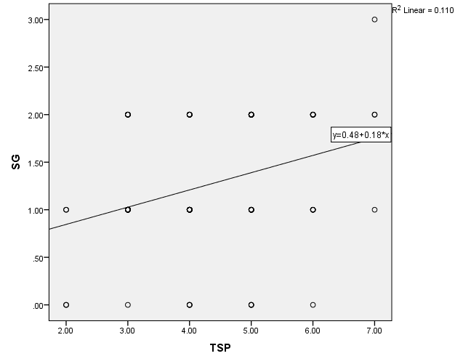
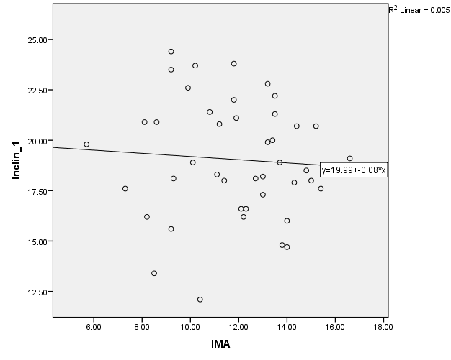
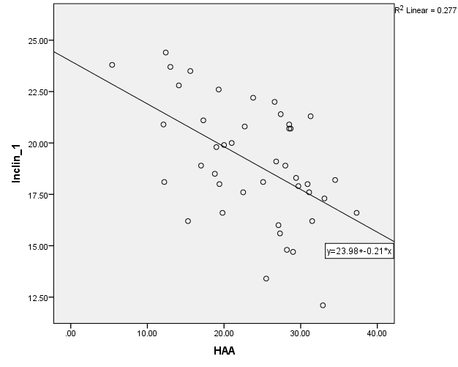
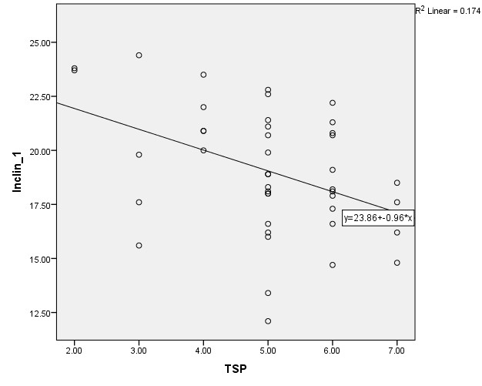
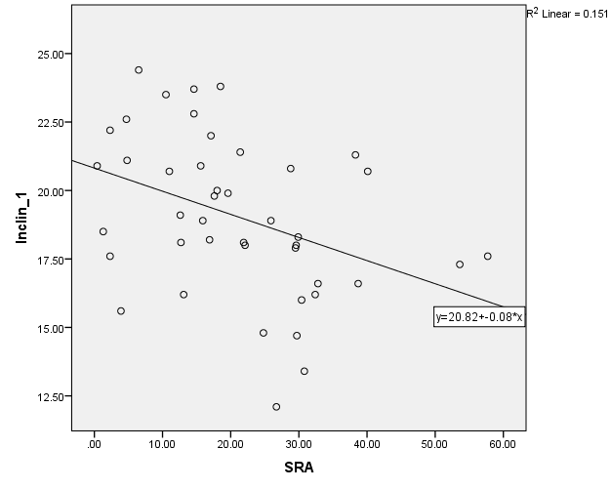
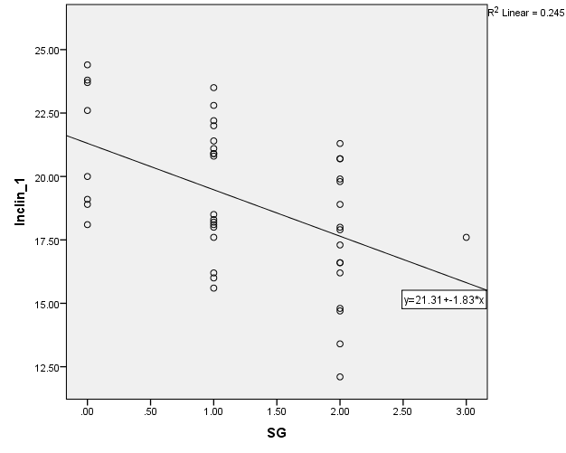
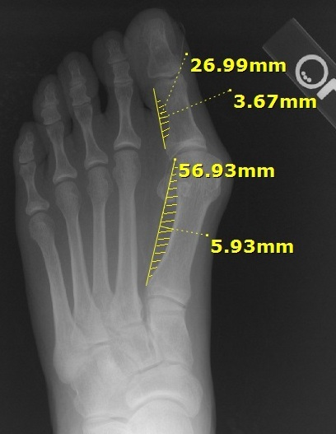
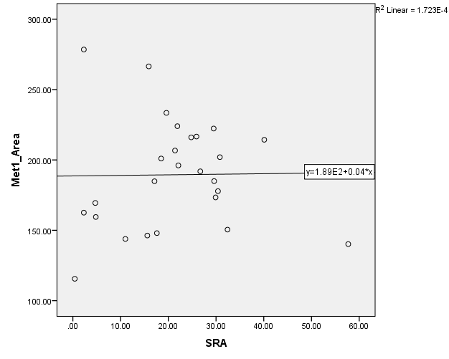
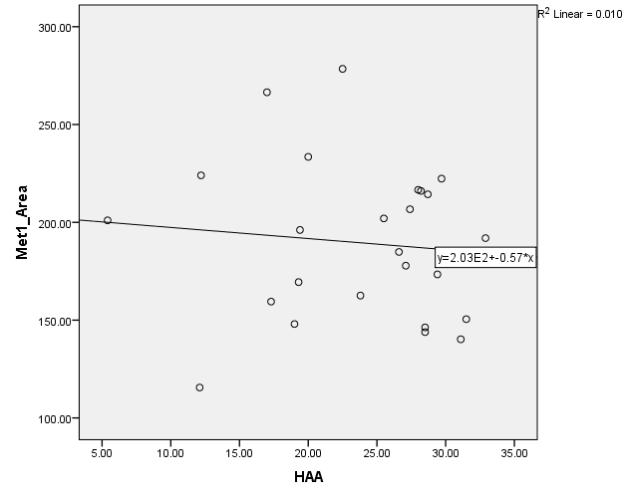
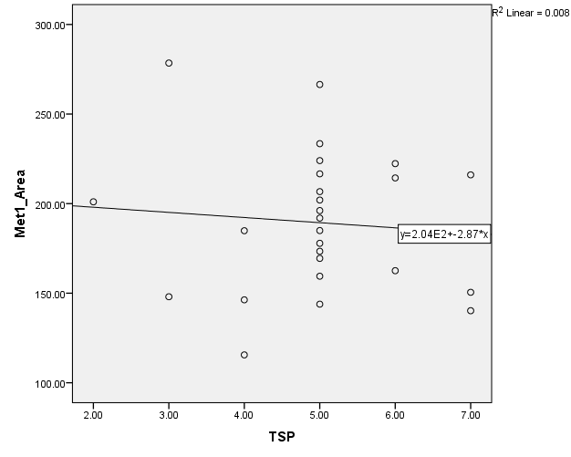
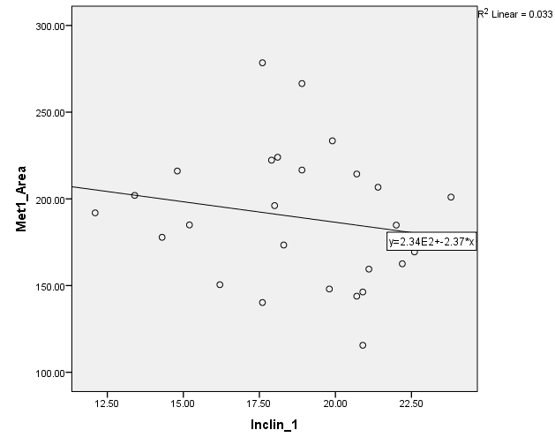
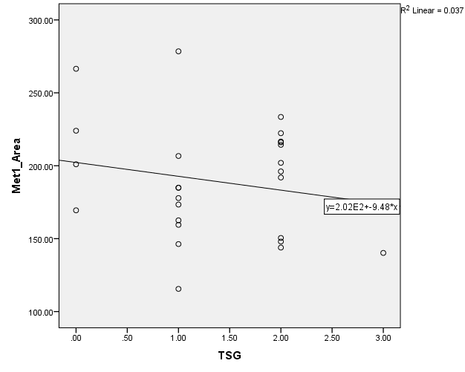
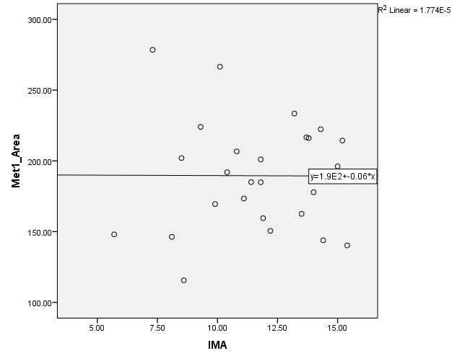
Quantitative assessment of triplanar first metatarsophalangeal joint radiographic parameters Todd Hasenstein, DPMª, and Andrew J. Meyr, DPM FACFAS^{b} ªResident, Temple University Hospital Podiatric Surgical Residency Program, Philadelphia, Pennsylvania ^{b}Associate Professor and Residency Program Director, Department of Podiatric Surgery, Temple University School of Podiatric Medicine and Temple University Hospital, Philadelphia, Pennsylvania (AJMeyr@gmail.com)* *Please don’t hesitate to contact AJM with any questions/concerns. He’s happy to provide you with a .pdf of this poster if you email him.
Statement of Purpose and Literature Review
Results
Discussion
Our group has previously performed an investigation into the transverse plane radiographic parameters utilized in the assessment of the hallux abductovalgus (HAV) deformity and established a quantitative basis for defining normal versus abnormal measurements [1]. This analysis, however, only described the transverse plane whereas HAV is generally considered to be a triplanar deformity involving the transverse, sagittal and frontal planes []. Despite this widely held belief, there are very few investigations that specifically describe the quantitative relationship between these three planes during the pathologic development of the HAV deformity [].
The objective of this original investigation was to quantitatively evaluate measurement of the frontal plane in the HAV deformity, and to examine the relationship between the transverse, sagittal and frontal planes.
Results are displayed in the following graphs with provided data interpretations:
As with any scientific investigation, critical readers are encouraged to review the study design and results and reach their own conclusions, while the following represents our conclusions based on the specific results. As scientists, we also never consider data to be definitive, but do think that these results are worthy of attention and future investigation.
-First, these results provide evidence in support of a triplanar component to the development of the hallux abductovalgus deformity. We observed consistent and statistically significant correlations between the transverse, sagittal and frontal planes utilizing commonly performed radiographic parameters. As transverse plane deformity increased, frontal plane deformity increased and the 1st metatarsal inclination angle decreased. And as frontal plane deformity increased, the 1st metatarsal inclination angle decreased. We believe that these results reinforce evaluation and treatment of this deformity with emphasis in all three planes.
-Second, these results do not support a subjective evaluation of the lateral “curvature” of the first metatarsal and hallux proximal phalanx as a surrogate for frontal plane deformity. We observed no substantial correlation between this finding and the progression of radiographic deformity in the frontal, transverse or sagittal planes. We believe that these results indicate that the frontal plane deformity warrants specific and individual evaluation.
In conclusion, we hope that the results of this investigation add to the body of knowledge and lead to future investigations into the progression, evaluation and treatment of the hallux abductovalgus deformity.
Part 1: Relationship of the frontal and transverse planes.
We first plotted radiographic measures of the transverse plane (first intermetatarsal angle [IMA], hallux abductus angle], and tibial sesamoid position [TSP]) against radiographic measures of the frontal plane (sesamoid rotation angle [SRA] and tibial sesamoid grage [SG]) and analyzed the data with linear and Loess best fit lines with calculation of a correlation coefficient (linear best fit lines pictured).
P = 0.017*
P < 0.000*
P < 0.000*
This series of graphs plots transverse plane radiographic parameters against frontal plane radiographic parameters. The observed positive relationships (ranging from R² 0.063-0.181) indicates “weak” to “moderate” positive correlations. All were statistically significant with a Pearson’s correlation coefficient to p < 0.05.
This indicates that as transverse plane HAV deformity increases, frontal plane deformity would also be expected to increase.
P = 0.004*
P = 0.002*
P = 0.002*
Part 2: Relationship of the sagittal and transverse planes.
We then plotted radiographic measures of the transverse plane (first intermetatarsal angle [IMA], hallux abductus angle], and tibial sesamoid position [TSP]) against a radiographic measure of the sagittal plane (first metatarsal inclination angle [Inclin_1]) and analyzed the data with linear and Loess best fit lines with calculation of a correlation coefficient (linear best fit lines pictures).
P = 0.665
P < 0.000*
P = 0.005*
This series of graphs plots transverse plane radiographic parameters against a sagittal plane radiographic parameter. “Moderate” negative relationships were observed between both the hallux abductus angle and tibial sesamoid position and the 1st metatarsal inclination angle indicating that as these transverse plane HAV parameters increased, the 1st metatarsal inclination angle decreased. These were statistically significant to p < 0.05 with a Pearson’s correlation coefficient. No substantial relationship was observed between the first intermetatarsal angle and the 1st metatarsal inclination angle.
Methodology
Following IRB approval, pre-operative weight-bearing DP, lateral, and sesamoid axial radiographs of 89 feet undergoing elective reconstruction of the first metatarsophalangeal joint were evaluated for radiographic parameters in the transverse (1st intermetatarsal angle [IMA], hallux abductus angle [HAA], tibial sesamoid position [TSP]), frontal (tibial sesamoid grade [SG], sesamoid rotation angle [SRA]) and sagittal (first metatarsal inclination angle [Inclin_1]) planes []. Data points were then graphically depicted against each other on frequency scatter plots and fit with linear and Loess best fit lines (including calculation of a Pearson’s correlation coefficient) to establish quantitative and qualitative relationships.
Part 3: Relationship of the frontal and sagittal planes.
We then plotted radiographic measures of the frontal plane (sesamoid rotation angle [SRA] and tibial sesamoid grage [SG]) against measure of the sagittal plane (first metatarsal inclination angle [Inclin_1]) and analyzed the data with linear and Loess best fit lines with calculation of a correlation coefficient (linear best fit lines pictured
P = 0.010*
P = 0.001*
This series of graphs plots frontal plane radiographic parameters against a sagittal plane radiographic parameters. “Moderate” negative relationships were observed between both the sesamoid rotation angle and the tibial sesamoid grade and the 1st metatarsal inclination angle, and both were statistically significant to p < 0.05 with a Pearson’s correlation coefficient. This indicates that as frontal plane HAV increases, the 1st metatarsal inclination angle would be expected to decrease.
Additionally, we have observed that it is common in clinical practice to associate increased frontal plane deformity with an increase in the relative “curvature” of the lateral first metatarsal and/or lateral hallux proximal phalanx shafts on DP radiographs (Figure 1) []. On 26 of these radiographs we utilized a computer program to define the area of this curvature ( Met1_Area and Phalanx_Area), and subsequently quantitatively measured it with the frontal plane radiographic parameters to define any association.
Part 4: Relationship of first metatarsal lateral “curvature” to the frontal plane.
We objectified the curvature along the lateral aspect of the first metatarsal shaft on a WB DP radiograph (which is commonly associated with frontal plane rotation) by calculation of the area under the curve (Met1_Area). We then graphically depicted this area against measurements of the cardinal planes. We identified no substantial relationship of this curvature to frontal, transverse or sagittal plane deformity.
Frontal Plane:
Transverse Plane:
Sagittal Plane:
References
P = 0.949
P = 0.621
P = 0.673
P = 0.374
[] Meyr AJ, Myers A, Pontious J. Descriptive quantitative analysis of hallux abductovalgus transverse plane radiographic parameters. J Foot Ankle Surg/ 2014 Jul-Aug; 53(4): 397-404.
[] Dayton P, Kauwe M, Feilmeier M. Clarification of the anatomic definition of the bunion deformity. J Foot Ankle Surg. 2014 Mar-Apr; 53(2): 160-3.
[] Dayton P, Feilmeier M, Hirschi J, Kauwe M, Kauwe JS. Observed changes in radiographic measurements of the first ray after frontal plane rotation of the first metatarsal in a cadaveric foot model. J Foot Ankle Surg. 2014 May-Jun; 53(3): 274-8.
[] LaPorta GA, Nasser EM, Mulhern JL, Malay DS. The mechanical axis of the first ray: a radiographic assessment in hallux abducto valgus evaluation. J Foot Ankle Surg. 2016 Jan-Feb; 55(1): 28-34.
[] Cancilleri F, Marinozzi A, Martinelli N, Ippolito M, Spiezia F, Ronconi P, Denaro V. Comparison of plantar pressure, clinical and radiographic changes of the forefoot after biplanar Austin osteotomy and triplanar Boc osteotomy in patient with mild hallux valgus. Foot Ankle Int. 2008 Aug; 29(8): 817-24.
[] Marinozzi A, Martinelli N, Ronconi P, Cancilleri F, Papalia R, Denaro V. A new device for performing triplanar distal osteotomy for hallux valgus. J Am Podiatri Med Assoc. 2009 Nov-Dec; 99(6): 536-40.
P = 0.343
P = 0.984
This series of graphs plots frontal plane (sesamoid rotation angle [SRA] and sesamoid tibial grade [TSG]), transverse plane (hallux abductus angle [HAA], first intermetatarsal angle [IMA] and tibial sesamoid position [TSP]), and sagittal plane (first metatarsal inclination angle [Inclin_1]) radiographic parameters against a measure of the area under the curvature of the lateral aspect of the first metatarsal without identification of a substantial relationship or statistically significant correlation. Similar graphs with lack of evident relationship were produced when measuring these radiographic parameters against the area under the curvature of the lateral aspect of the hallux proximal phalanx.

