Slide 1
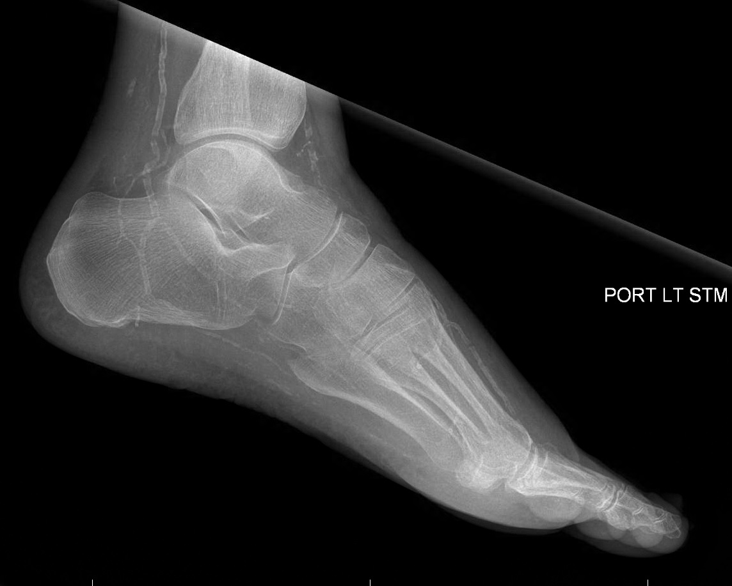
Prevalence of Lower Extremity Calcification in Patients with Diabetes Complicated by Foot Disease at an Urban US Tertiary Care Center Vanessa Cardenas, DPMª, Kyung Seo, DPMª, Shyam Sheth, DPMª, and Andrew J. Meyr, DPM FACFAS^{b} ªResident, Temple University Hospital Podiatric Surgical Residency Program, Philadelphia, Pennsylvania ^{b}Associate Professor and Residency Program Director, Department of Podiatric Surgery, Temple University School of Podiatric Medicine and Temple University Hospital, Philadelphia, Pennsylvania (AJMeyr@gmail.com)* *Please don’t hesitate to contact AJM with any questions/concerns. He’s happy to provide you with a .pdf of this poster if you email him.
Statement of Purpose and Literature Review
Discussion
There are approximately 30 million diabetics in the US, and the diagnosis and treatment of diabetic foot disease in these patients forms a substantial portion of US healthcare expenditure. One of the primary components of a diabetic foot evaluation is a quantitative assessment of the arterial perfusion of the extremity, usually by means of non-invasive vascular testing and the ankle-brachial index (ABI). Unfortunately however, patients with certain co-morbidities including diabetes have the potential for medial arterial calcific sclerosis leading to falsely elevated ABIs, making results of questionable reliability.
Prevalence rates of arterial calcification have not been as well documented for the foot and ankle as they have for the rest of the body, despite the strong association between arterial calcification and poor clinical outcomes. This calcification occurs most frequently in the coronary arteries, aorta and proximal peripheral arteries and is associated with age.
The objective of this investigation was to determine the prevalence of lower extremity arterial calcification in a cohort of diabetic patients with foot pathology receiving in-patient treatment at an urban US tertiary healthcare system.
As with any scientific investigation, critical readers are encouraged to review the study design and results and reach their own conclusions, while the following represents our conclusions based on the specific results. As scientists, we also never consider data to be definitive, but do think that these results are worthy of attention and future investigation.
The results of this investigation provide foot and ankle surgeons with unique information on the high prevalence of arterial calcification in diabetic patients with foot pathology:
-The majority of patients (68%) demonstrated evidence of arterial calcification on at least one test, with positive radiographic findings present in 52% of cases.
-Patients with ESRD were more likely to demonstrate evidence of arterial calcification (OR 3.55; 95% CI: 1.68-7.71), while patients with a positive smoking history were less likely (OR 0.481; 95% CI: 0.295-0.783). We found no association with HbA1c greater or less than 8% (OR 0.889; 95% CI: 0.559-1.415).
We believe this information should have an effect on the interpretation of non-invasive vascular testing and decision making with respect to healing potential in patients with diabetes.
Figures 1: We analyzed foot radiographs from 367 consecutive diabetic patients admitted to an urban US tertiary health care center with a foot and ankle surgery consultation. We specifically looked for radiographic evidence of arterial calcification in the proximal first intermetatarsal space (dorsalis pedis artery), at the anterior ankle (anterior tibial artery), and at the posterior ankle (posterior tibial artery).
Figure 2: We additionally evaluated non-invasive vascular testing (if available) for any reporting of non-compressible vessels in the lower extremity.
Results
Three hundred and sixty seven patients met investigation inclusion criteria. The mean ± standard deviation (range) age was 58.0 ± 12.17 years (20-93 years). 218 (59.40%) were male. 196 (53.41%) were classified as black, 78 (21.25%) as white, 1 (0.3%) as Asian, and 92 (25.07%) as other. 92 (23.71%) were Hispanic. 117 (31.88%) had a smoking history. 73 (19.89%) had ESRD. HbA1c data was available from 307 patients with a mean ± standard deviation (range) of 8.90 ± 2.56% (4.6-17.5%). Non-invasive vascular testing was performed on 265 (72.21%) patients.
There was radiographic evidence of calcification in 192 (52.32%) of 367 patients. This included positive findings in 178 (48.5%) of DP radiographs in the proximal first interspace, 162 (44.14%) of anterior tibial arteries at the ankle, and 160 (43.60%) of posterior tibial arteries at the ankle.
With respect to the non-invasive vascular testing, any reporting of non-compressibility or an ABI > 1.1 was observed in 153 (57.74%) of the 265 performed tests (153/367; 41.69% of patients).
Patients with ESRD were statistically more likely to have vessel calcification than those without ESRD (OR 3.55 [95% CI: 1.68-7.71]). Patients with a history of smoking were statistically less likely to have vessel calcification than those without a smoking history (OR 0.481 [95% CI: 0.295-0.783]). Patients with a HbA1c ≥ 8.0% were not more or less likely to have vessel calcification than those with a HbA1c < 8.0% (OR 0.889 [0.559-1.415]).
Demographic Outcomes
-Total Included Patients (n=367) -Male: 218 (59.40%) -Black: 196 (53.41%) -White: 78 (21.25%) -Asian: 1 (0.3%) -Other: 92 (25.07%) -Hispanic: 92 (23.71%) -Smoking History: 117 (31.88%) -Odds Ratio 0.481* (95% CI: 0.295-0.783) -ESRD History: 73 (19.89%) -Odds Ratio 3.55* (95% CI: 1.68-7.71) -HbA1c: 8.90 ± 2.56% (4.6-17.5%) -Odds Ratio 0.889 (95% CI: 0.559-1.415) -Radiographic evidence of calcification: 192 (52.32%) -Dorsalis Pedis Artery: 178 (48.5%) -Anterior Tibial Artery: 162 (44.14%) -Posterior Tibial Artery: 160 (43.60%) -Non-invasive evidence of calcification: 153 (57.74%) -94 (25.61%) of patients demonstrated evidence of calcification on both radiographs and non-invasive testing, meaning that a total of 251 (68.39%) patients demonstrated arterial calcification on at least one test.
Methodology
References
Following IRB approval, a retrospective chart review was performed of all patients with diabetes seen in consultation by the foot and ankle surgery service at Temple University Hospital for a lower extremity complaint with plain film radiographs over a twelve month data collection period (July 2014-June 2015). The presence of medial arterial calcific sclerosis was defined as either: 1) radiographic evidence of vessel calcification (specifically from the proximal 1st intermetatarsal space on a AP projection [dorsalis pedis artery], the anterior ankle from a lateral projection [anterior tibial artery], or the tarsal tunnel/posterior ankle from a lateral projection [posterior tibial artery]) and/or 2) non-invasive vascular testing which resulted in any reporting of non-compressibility or an ABI > 1.1. Additional patient demographics were extracted including age, gender, race, ethnicity, most recent HbA1c, smoking history, and history of end stage renal disease (ESRD).
[1] Allison MA, Criqui MH, Wright CM. Patterns and risk factors for systemic calcified atherosclerosis. Arterioscler Thromb Vasc Biol. 2004; 24: 331-336.
[2] Churchill TW, Rasania SP, Rafeek H, Mulvey CK, Terebula K, Ferrari V, Jha S, Lilly SM, Eraso LH, Reilly MP, Qasim AN. Ascending and descending thoracic aorta calcification in type 2 diabetes mellitus. J Cardiovasc CT.
[3] Sharma A, Scammell BE, Fairbairn KJ, Seagrave MJ, Game FL, Jeffcoate WJ. Prevalence of calcification in the pedal arteries in diabetes complicated by foot disease. Diabetes Care. 2010 May; 33(5): e66.
[4] David Smith C, Gavin Bilmen J, Iqbal S, Robey S, Pereira M. Medial artery calcification as an indicator of diabetic peripheral vascular disease. Foot Ankle Int. 2008 Feb; 29(2): 185-90.
[5] Young MJ, Adams JE, Anderson GF, Boulton AJ, Cavanagh PR. Medial arterial calcification in the feet of diabetic patients and matched non-diabetic control subjects. Diabetologia. 1993 Jul; 36(7): 615-21.
[6] Everhart JE, Pettitt DJ, Knowler WC, Rose FA, Bennett PH. Medial arterial calcification and its association with mortality and complications of diabetes. Diabetologia. 1988 Jan; 31(1): 16-23.
[7] Rocha-Singh KJ, Zeller T, Jaff MR. Peripheral Arterial Calcification: Prevalence, mechanism, detection and clinical implications. Cath and Cardio Inter
[8] Arain FA, Ye Z, Bailey KR, Chen Q, Liu G, Leibson CL, Kullo IJ. Survival in patients with poorly compressible leg arteries. J Am C Cardiology.
[9] Wu M, Rementer C, Giachelli CM. Vascular calcification: an update on mechanisms and challenges in treatment. Calcif Tissue Int. 2013; 93: 365-373.
[10] Lew E, Nicolosi N, Botek G. Lower extremity amputation risk factors associated with elevated ankle brachial indices and radiogrpahic arterial calcification. J Foot Ankle Surg. 2015 May-Jun; 54(3): 473-7.
[11] Aragon-Sanchez J, Lazaro-Martinez JL. Factors associated with calcification in the pedal arteries in patients with diabetes and neuropathy admitted for foot disease and its clinical significance. Int J Low Extrem Wounds. 2013 Dec; 12(4): 252-5.

