Slide 1
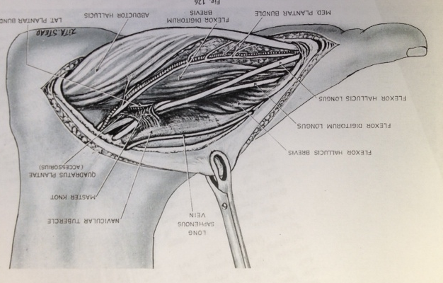
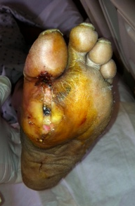
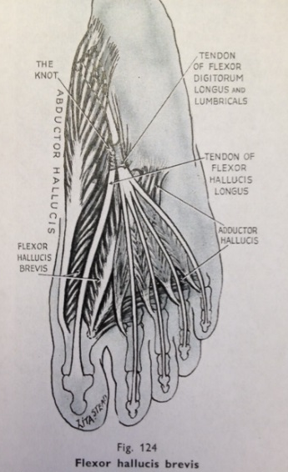
Intertendinous communication at the Master Knot of Henry: Implications for the Spread of Diabetic Foot Infection Sayed Ali, MDª, Nicole Griffin, PhD^{b}, Whitney Ellis, DPM^{c}, and Andrew J. Meyr, DPM^{d} ªAssociate Professor, Department of Radiology, Temple University Hospital, Philadelphia, Pennsylvania ^{b}Assistant Professor, Department of Anatomy and Cell Biology, Temple University School of Medicine, Philadelphia, Pennsylvania ^{c}Resident, Temple University Hospital Podiatric Surgical Residency Program, Philadelphia, Pennsylvania ^{d}Associate Professor, Department of Podiatric Surgery, Temple University School of Podiatric Medicine, Philadelphia, Pennsylvania (AJMeyr@gmail.com)* *Please don’t hesitate to contact AJM with any questions/concerns. He’s happy to provide you with a .pdf of this poster if you email him.
Statement of Purpose and Literature Review
Methodology
Figures
The Master Knot of Henry was intially described by Egyptian surgeon Arnold Henry in his 1946 text Extensile Exposure (Figure 1) as an intertendinous communication between the flexor hallucis longus (FHL) and flexor digitorum longus (FDL) tendons within the plantar foot musculature [1]. This structural anatomy has both biomechanical and functional implications as described by Sarrafian and others with the FHL having the potential for independent action on the lesser digits [2-4]. Specifically, these intertendinous connections have been shown to affect the medial lesser digits (second and third) more commonly than the lateral lesser digits (fourth and fifth). Additionally, this communication has importance with respect to foot and ankle reconstructive procedures, namely the FDL tendon transfer for the flexible pes valgus deformity and the FHL tendon transfer for chronic Achilles tendinopathy.
This anatomy may also have an underappreciated effect on the development and treatment of diabetic foot infections. It is important to have a full appreciation of lower extremity anatomic relationships before undertaking diabetic foot surgery. Specifically with respect to acute deep space infection, potential sources of infection transmission along deep fascial planes and soft tissue structures should guide incision planning, the intra-operative surgical course, and the degree of resected tissue [5].
This may be particularly true with infections originating submetatarsal 1 and involving the medial plantar compartment. Roukis recently reported a 2-year re-amputation rate of nearly 20% following any amputation involving the first ray [6]. The most common source of infection transmission in this location may be the flexor hallucis longus (FHL), which has been nicknamed the “infection super-highway” of the foot because of its intricate involvement with multiple other structures and compartments of the foot [7,8] (Figure 2). The FHL has the potential to transmit infection throughout 1) the medial compartment of the plantar foot through the abductor hallucis and flexor hallucis brevis muscles, 2) the central and lateral aspects of the foot through the adductor hallucis muscle and the flexor digitorum longus (FDL) at the knot of Henry, and 3) the rearfoot through the Quadratus Plantae muscle near the knot of Henry.
Additionally, the Quadratus Plantae muscle belly lies in close anatomic proximity to the Knot of Henry. This muscle takes its origin from the calcaneus and may represent a potential site of infection communication between the forefoot and the rearfoot.
The objective of this investigation was to study the Master Knot of Henry for its potential for infection transmission from the flexor hallucis longus and medial plantar compartment of the foot to the flexor digitorum longus and other plantar foot compartments.
This investigation involved CT tenography and gross anatomic dissection of ten embalmed, cadaveric limbs. Initially 5-10cc of a 1:4 dilution of Omnipaque 300 and normal saline was injected into the sheath of the flexor hallucis longus at the level of the sesamoids of the hallux. CT images were then obtained in the axial plane using a Siemens Sensation 16 multidetector sensor CT scanner, with sagittal and coronal reformatted images.
Dissection of the limbs was then performed for specific evaluation of the known variable intertendinous connections between the FHL and FDL/Quadratus Plantae muscles.
We also identified a clinical case of a patient who progressed from partial first ray resection to transmetatarsal amputation with CTfindings of soft tissue emphysema at the Knot of Henry while the first ray was intact.
Figure 3: Communication between the flexor hallux longus (FHL) and flexor digitorum longus (FDL) on CT and anatomically at the Master Knot of Henry.
Figure 3A is axial CT images of the midfoot viewed at soft tissue and bone windows while Figure 3B shows the corresponding gross anatomical specimen viewed from the dorsal aspect. These demonstrate radiographic and anatomic communication between the FHL (solid arrows) and the FDL (shorter dashed arrows) with one or two intertendinous communicating slips between the two (longer dashed arrows). On the CT images, one can appreciate contrast filling from the FHL to the slips of the FDL through this communication at the knot of Henry.
Figures 1: Master Knot of Henry.
These two figures demonstrate the dessucation of the FHL and FDL in the plantar midfoot (from Dr. Henry’s original Extensile Exposure text).
Figure 2: FHL involvement with diabetic foot infections.
Foot infections originating submetatarsal head 1 in the area of the FHL may be associated with relatively poor clinical outcomes.
Figure 3A
Figure 3B
Figure 4: Communication between the flexor hallucis longus (FHL) and the quadrates plantae (QP) on CT and anatomically at the Master Knot of Henry.
Figure 4A is coronal (first two images) and axial CT images while Figure 4B shows the corresponding gross anatomical specimens viewed from the plantar aspect. These demonstrate radiographic and clinical communication between the FHL (solid arrows) and the QP (dash-dot arrows) with significant communication at the know of Henry (longer dashed arrows) between the FHL, FDL (smaller dashed arrows) and QP. On the CT images, contrast filling is observed retrogradely from the FHL to the QP, and also to the FDL (dashed-dot arrow in the third CT image).
Results
Cannulization of the FHL tendon sheath and subsequent injection of contrast media was successful in 6 limbs. In of these cases, retrograde flow into four of the individual tendons and tendon sheaths of the FDL was observed on CT (Figure 3). Upon dissection, this specimen was noted to have a large communicating intertendinous slip between the FHL and FDL. Another cadaver had contrast filling within the QP muscle on CT with an associated intertendinous slip between the FHL and QP upon dissection (Figure 4). The other four cadavers demonstrated no retrograde contrast filling of the FDL on CT, and demonstrated only tiny communications on dissection.
A clinical case was also observed in which a diabetic foot infection progressed from hallux infection and initial partial first ray resection to eventual osteomyelitis of all lesser metatarsals, with communication of soft tissue emphysema between the FHL and FDL on CT scan prior to initial surgical resection. (Figure 5).
Figure 4A
Figure 4B
Figure 5B
Figure 5: Clinical case of communication between the flexor hallux longus (FHL) and the flexor digitorum longus (FDL) at the Master Knot of Henry.
Figure 5A is sequential CT images while Figure 5B is sequential dorsoplantar foot radiographs over a period of several weeks. These demonstrate plain film radiographic evidence of remnant first metatarsal osteomyelitis following a partial first ray resection with progression of osteomyelitis across the forefoot and lesser metatarsals. The CT demonstrates soft tissue emphysema (small rounded arrows) initially at a soft tissue ulceration, then extending proximally along the FHL tendon sheath (solid arrow) to the knot of Henry and subsequently into the FDL tendon sheaths (shorter dashed arrows).
Conclusion
Figure 5A
References
As with any scientific investigation, readers are encouraged to review and critically assess the study design and specific results in order to reach their own independent conclusions, while the following represents our conclusions based on the preceding data. It is also important to note that as scientists we never consider data to be definitive, but we do think there are some interesting findings here worthy of attention and future investigation:
-Based on the preceding results, we conclude that the Master Knot of Henry serves as a potential source of communication of diabetic foot infections from the medial plantar compartment and FHL to the central plantar compartment, lateral forefoot and rearfoot through the potential pathways of the FDL and Quadratus Plantae.
-Diabetic foot surgeons should have a full appreciation of the anatomy of the Master Knot of Henry while performing procedures in this location and with infections involving these soft tissue structures.
[1] Henry AK. In: Extensile Exposure applied to Limb Surgery. The Williams and Wilkins Company, Baltimore; 1946. p163-171.
[2] Sarrafian SK. Myology. In Anatomy of the Foot and Ankle: Descriptive, Topographic, Functional, pp 199-250, edited by SK Sarrafian, J.B. Lippincott Company, Philadelphia, 1983.
[3] Wapner KL, Hecht PJ, Shea JR, Allardyce TJ. Anatomy of the second muscular layer of the foot: considerations for tendon selection in transfer for Achilles and posterior tibial tendon reconstruction. Foot Ankle Int 15(8): 420-4, 1994.
[4] O’Sullivan E, Carare-Nnadi R, Greenslade J, Bowyer G. Clinical significance of variations in the interconnections between flexor digitorum longus and flexor hallucis longus in the region of the knot of Henry. Clin anat 18(2): 121-5, 2005.
[5] Meyr AJ. Essential questions for surgical intervention of diabetic foot infections. Podiatry Today. Jan 2009; 21(1).
[6] Borkosky SL, Roukis TS. Incidence of re-amputation following partial first ray amputation associated with diabetes mellitus and peripheral sensory neuropathy: a systematic review. Diabet Foot Ankle. 2012; 3.
[7] Donovan A, Schweitzer ME. Current concepts in imaging diabetic pedal osteomyelitis. Radiol Clin North Am. 2008; 46(6): 1105-24.
[8] Ledermann HP, Morrison WB, Schweitzer ME, Raiken S. Tendon involvement in pedal infection: MR analysis of frequency, distribution and spread of infection. Am J Roentgenol. 2002; 179(4): 939-47.

